Slide 1


Madhavrao Pachupate
Agentic AI
Architecture Review
Reconstruct the system. Test the failure paths. Make the next
production decision defensible.

Slide 2







Agentic AI Architecture Review
Reconstruct the system. Test the failure paths. Make the next production decision defensible.
Operating claim
Trajectory
Action
Establish the foundational system
premise
Map model decisions and tool
usage
Evaluate recovery and
remediation steps
Evidence
Finding
Decision
Collect data from intent and
context
Analyze state and external
effects
Finalize ownership and next
steps

Slide 3





Every review begins
with one
production question
Workflow Potential
Can this workflow move from prototype to
supervised pilot?
Operational Safety
Can agents act without an unbounded failure
path?
System Scalability
What changes are required before autonomy or
data access expands?
Recovery Protocols
Can the team explain a run after an interruption?

Slide 4


Document what is implemented,
not what is claimed
As stated vs. As evidenced
Evidence like trace logs and tool contracts must substantiate system claims like
safety.
Architecture views
Reconstruct authority, autonomy, agent nodes, state, and trust boundaries for
audit.

Slide 5

The eight-stage review workflow
1. Frame
2. Intake
Define the decision, scope,
lifecycle, owners, and exclusions.
Inventory artifacts, versions,
environments, evidence quality, and
gaps.
3. Reconstruct
4. Select4. Select4. Select
Build the as-built system, agent,
state, data, and control views.Build
the as-built system, agent, state,
data, and control views.Build the as-
built system, agent, state, data, and
control views.
Choose representative,
consequential, degraded, and failed
paths.Choose representative,
consequential, degraded, and failed
paths.Choose representative,
consequential, degraded, and failed
paths.
5. Test hypotheses5. Test hypotheses5. Test hypotheses
6. Write findings6. Write findings6. Write findings
Ask what can fail, exceed authority,
evade detection, or resist
recovery.Ask what can fail, exceed
authority, evade detection, or resist
recovery.Ask what can fail, exceed
authority, evade detection, or resist
recovery.
Convert demonstrated failure paths
into atomic causal findings.Convert
demonstrated failure paths into
atomic causal findings.Convert
demonstrated failure paths into
atomic causal findings.
7. Sequence actions7. Sequence actions7. Sequence actions
Define containment,
recovery/observability, capability
changes, owners, and acceptance
evidence.Define containment,
recovery/observability, capability
changes, owners, and acceptance
evidence.Define containment,
recovery/observability, capability
changes, owners, and acceptance
evidence.
8. Decide and hand off8. Decide and hand off8. Decide and hand off
Record the verdict, conditions,
residual risks, expiry, and next
trigger.Record the verdict,
conditions, residual risks, expiry,
and next trigger.Record the verdict,
conditions, residual risks, expiry,
and next trigger.

Slide 6
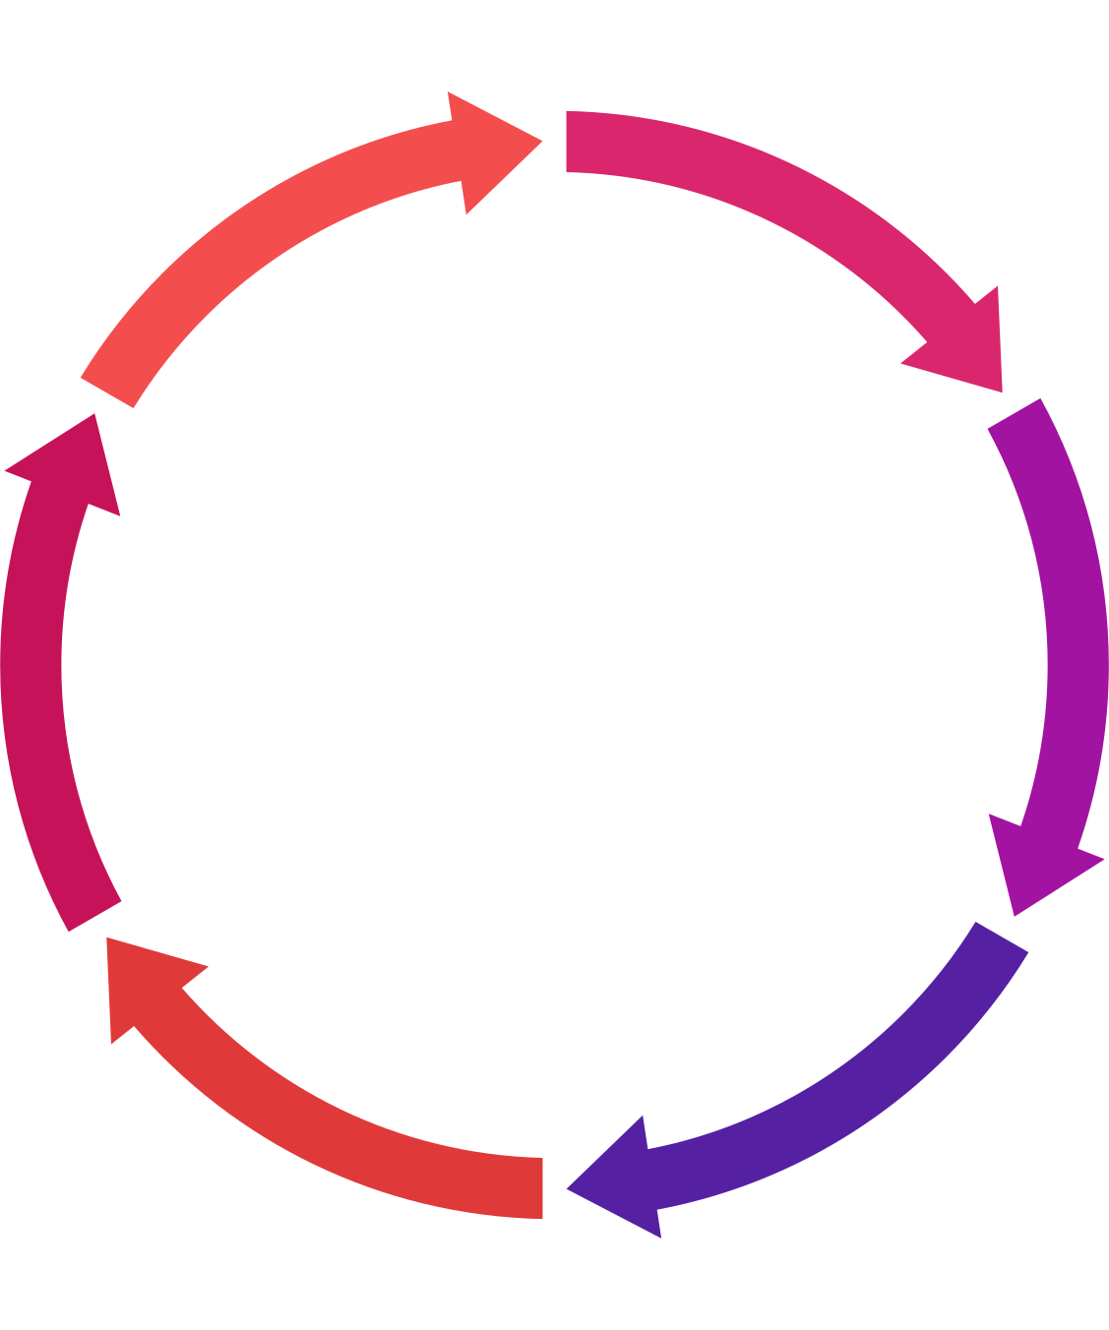
The unit of review is a trajectory
Success Path
High-Consequence
Representative successful path
High-consequence or high-autonomy path
Failure
Required
Trajectory Classes
Degraded
Real production failure where available
Degraded dependency or timeout path
Out-of-Scope
Recovery
Unauthorized or out-of-scope request
Interruption or recovery path

Slide 7
A concern becomes a finding only
when the system demonstrates it
Condition
Trigger
Failure
External payment
write and internal
checkpoint commit are
independent.
Worker terminates
after the payment API
returns success.
Recovery replays the
uncheckpointed
payment step.
Consequence
Control gap
A duplicate financial effect
occurs.
The tool contract has no deterministic
idempotency binding.

Slide 8

Every
recommendation
must end
in acceptance
evidence
Proceed
evidence supports the stated operating
boundary.
Proceed with conditions
explicit blockers must pass acceptance
evidence first.
Do not proceed / do not expand
the current risk exceeds the decision
boundary.
Insufficient evidence
the responsible action is to gather or generate
evidence.

Slide 9





Deliverables
One evidence spine, several useful outputs
1
2
3
4
As-built architecture record
Deep-dive risk ledger
Written assessment
Client readout
Includes implementation facts,
observed or claimed status,
topology, state, tools,
boundaries, controls, and
evidence or unknowns.
Includes trajectories,
hypotheses, findings, actions,
decisions, and residual risk.
Includes executive verdict,
evidence quality and limitations,
critical failure paths, and
prioritized remediation.
Includes decision first, concise
architecture and trajectory
visuals, source IDs on every
material conclusion, acceptance
criteria, and next trigger.

Slide 10
Review scope
Establishes observed evidence, architectural divergence,
material production risks, risk-reducing changes, ownership
of unknowns, and required evidence for future decisions.
Review boundaries
Summary
Does not automatically establish compliance, pen-test/load-
test coverage, model intelligence, absence of external
vulnerabilities, or safety post-policy changes.
A defensible review is
explicit about its limits
Final output description
The output is not a score, but a defensible description of the
build, its behavior under consequential conditions, and
necessary prerequisites for the next release.
Call to action
Focus on one system, workflow, and production decision;
identify representative and difficult trajectories; and gather
all necessary verification artifacts.

